Slide 1
Agenda
What is a Test Case ?
Definitions
Why we write test cases?
Types of test cases
Test Case attributes
Types of test cases
Examples of test cases
Best practices
Exercise

Slide 2
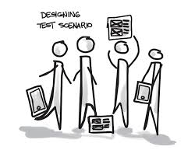
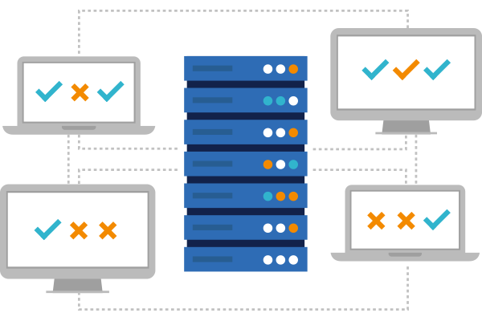
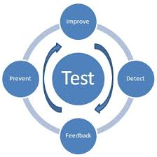
Definitions
Test scenario
Test Suite
Test cycle
All possible attributes, functionalities, features and aspects of the software product that needs to be tested is commonly referred as test scenario.
A set of several test cases for a component or system under test, where the post condition of one test is often used as the precondition for the next one.
Execution of the test process against a single identifiable release of the test object.

Slide 3
Test cases
What is a test case?
A set of test input, execution conditions, actions and an expected result, to exercise if a feature of an application is working correctly.
An ordered sequence of inputs with conditions and variables that determine whether a piece of an application is functioning properly.
The features are defined in the requirements specification document.
Why we write test cases?
The basic objective of writing test cases is to validate the testing coverage of the application.
Types of test cases
Functional, nonfunctional
Positive, negative
User-acceptance (end-to-end)
Integration
And many more…

Slide 4
Test case attributes
Each test case has:
ID
Title
Priority
Assumptions/Prerequisites/Preconditions
Summary/Short description
Steps to be executed
Expected result for each step
Actual result for each step (filled in while execution)
Execution type (manual/automation)
Status
Comments

Slide 5
Test case attributes
ID:
Identifier of a Test Case is assigned automatically by the Test Management Tool and cannot be changed by users.
Title:
Short description about the function that should be tested
(ex. Verify sorting when you add item; Add new user as admin)
Summary:
Short sentence or two about the aspect of the system is being tested. If this gets too long, break the test case in two test cases

Slide 6
Test case attributes
Assumptions/Prerequisites/Preconditions:
Assumptions that must be met before the test case can be run.
(ex. A test user is created, The user is logged in)
Steps to be executed:
Input actions that describe the test scenario.
Expected result for each step:
Describe checkpoints and expected behavior of a tested product or system
Actual result for each step:
The field is filled in when the test case is executed.
When the result differ from the expected result and there is a bug.

Slide 7
Test case attributes
Execution type:
Test designer could set automation support of the test [MANUAL/AUTOMATED]
Status:
The status is set up when the test case is executed
Not Run, Passed, Failed, Blocked
Comments:
Comments are added when the test case is executed
Describes the bug/defect
Links the test case with the bug/defect (depends on the Test Management System)

Slide 8
Types of test cases
Functional:
In functional testing, test cases are used to test the application’s interface and determine how an application and the user interact.
Positive:
Positive Testing is testing process where the system is validated with the valid input data.
In this testing tester always check for only valid set of values and check if a application behaves as expected.
Negative:
A negative test, checks if a application behaves as expected with its negative inputs.
The main intention of this testing is to check whether the software application is not showing error when supposed to & showing error when not supposed to.
Nonfunctional:
In non-functional testing, test cases are used to demonstrate how well the product behaves
Take care about the customer expectations (reliability, capacity, memory, speed, etc…)
Performance, Security and Usability Testing

Slide 9
Examples of test cases
Functional
Positive:
Enter only integers in a field asking for user age.
If there is no error message and the form can be submitted successfully, this test case will have status “passed”.
Negative:
Enter different characters (both integers and letters) in a field asking for user age.
If there is no error message and the form can be submitted successfully, this test case will have status “failed”.
Nonfunctional:
Performance, Security, Usability, Load, Compatibility

Slide 10
Best practices
Tips and tricks:
Keep a good traceability between test cases and client requirements
Remember to cover positives and negative scenarios
Order test cases according to the priority. So you can execute first the one with higher priority
Make test cases reusable and maintainable
Imagine Yourself as the End-User
User – friendly and intuitive flow
By putting yourself in the shoes of the end-user, your test cases will provide better coverage, and lead to more successful testing.
Make the steps easy to follow. Even for people that is not related with the project
Ask Questions, Contribute Feedback and Make Suggestions
Analyze the specification, ask for contradictory or unclear requirements.
It’s often the tester who really uses the product for the first time.
Test Your Test Cases
Review all test cases with the mind of the tester.
If a test case requires logging in, have you included the login credentials?

Slide 11
Example
Title:
Remove all the information provided in the form
Summary:
All the fields in the form can be cleared at once by clicking on the button "Clear". The information entered will be lost.
Assumptions/Prerequisites:
The “Risk Identification” form is opened.
Step actions: Expected result:
Fill in some of the available fields 1. The data is entered.
Click on the “Clear” button. 2. The data is cleared. The fields are empty.
Fill in all the fields in the form. 3. The data is entered.
Click on the “Clear” button. 4. The data is cleared. The fields are empty.

Slide 12
Exercise description - 1
Write test cases for the Risk Identification form considering the following:
Project, Statement and Title are required fields
Character limit of Statement field is 2000
Reporter field is grey out and prefilled with reporter name and surname
Title field is alphanumeric
Maximum character of Title field is 32
Owner and Actionee fields are alphabetic
Risk level is DD list with following values: Project, Account, BU, Company
Risk type is DD list with following values: Risk, Issue

Slide 13
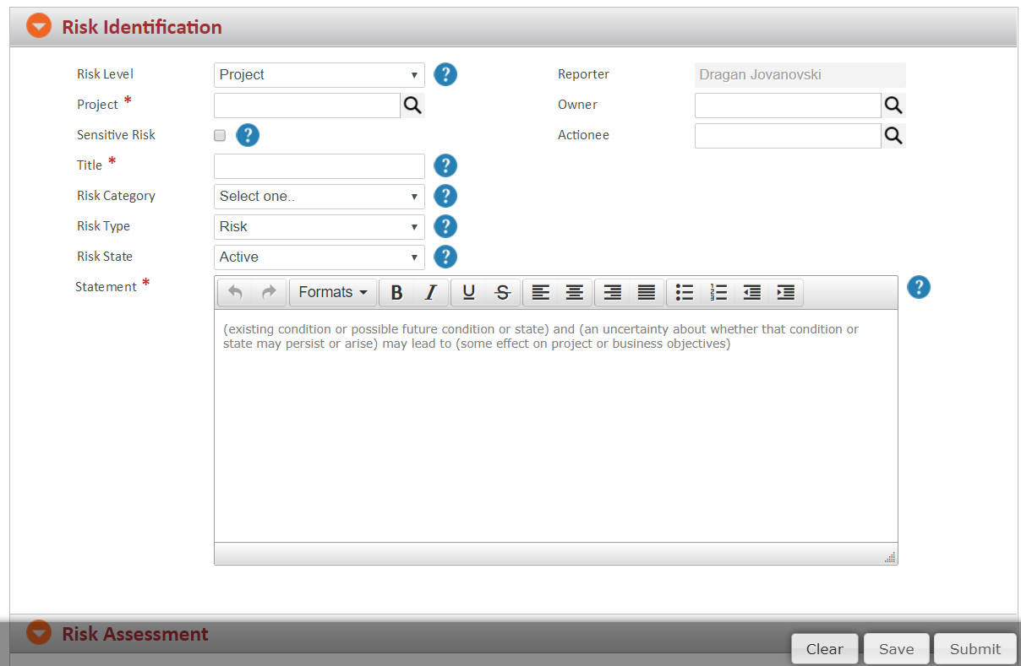
Risk Identification form

Slide 14
Exercise description - 2
Write test cases for the Risk Assessment form considering the following:
Risk cost fields are numeric
Risk proximity, End Date and Review Date are date fields in following format DD/MM/YYYY

Slide 15
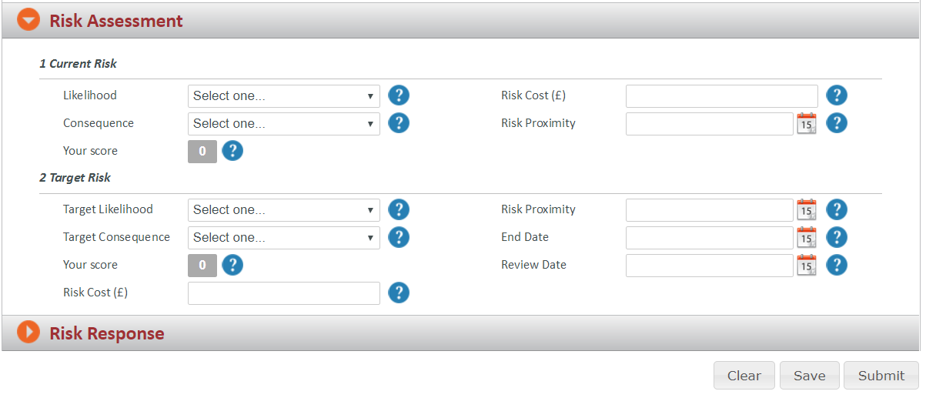
Risk Assessment form

